Slide 1
PHASED ARRAY SPEAKER SYSTEM
Under the guidance of,
S. Bibin Sam Paul
Assistant Professor (sr. Gr.)
By,
MohammedArsath(120051601063)
RajaRaman.G(120051601094)
Rohit Kumar.S(120051601101)
Final Year, ECE - B

Slide 2
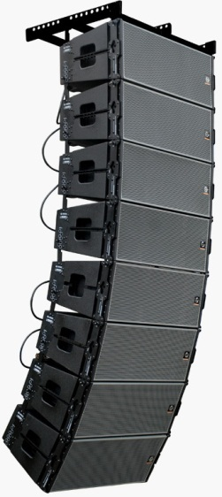
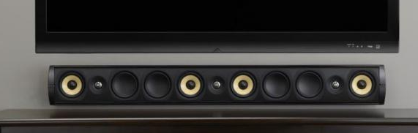
PHASED ARRAY SPEAKERS
Over the past few decades, digital signal processors (DSPs) have become available at a reasonable cost. This forces the question Now that it is possible to individually control the magnitude and phase of every loudspeaker in an array called phase array speaker system.
Manipulating the magnitude and phase of every loudspeaker in an array of loudspeakers is commonly referred to as “beam steering.”
Line Array systems
Phase Array systems

Slide 3
OBJECTIVE
The aim of the phased array speakers is to provide the maximum sound coverage over an entire area along with best sound clarity. The voices and the sound effects could be more easily differentiated. This system is comparatively cheaper when compared with its counterparts.

Slide 4
INTRODUCTION
A phased array speaker system to generate flexible, directional sound.
The system samples a standard audio input signal at approximately 44.1 kHz, and then outputs this signal to each of 6-12 speakers, each with a variable delay.
This simple technique allows audio frequency sound to be heard in only selected regions within the room or other auditory space.
Multiple regions with multiple soundtracks can be created by simultaneously playing variously delayed soundtracks over each of the speakers in the array.
Sound waves from different loudspeakers can both combine or cancel depending on the relative phase relationships between the sound waves, it is possible to manipulate the phase (and magnitude) of the sound from two or more loudspeakers to control where the sound cancels and where the sound sums.

Slide 5
HARDWARE DESIGN
X12
STANDARD AUDIO INPUT
INPUT BUFFER/LEVEL SHIFTER
AADC
ATMEGA 328 MICROCONTROLLER
DAC
SPEAKER AMPLIFIER

Slide 6
SOFTWARE USED
WinAVR used for programming the microcontroller.
EAGLE software to design circuits for fabrication.

Slide 7
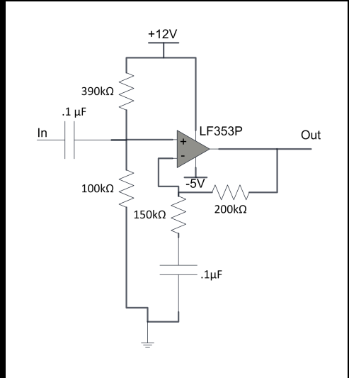
PRE AMPLIFIER CIRCUIT
Corner frequency of this input high pass filter 1/(RC)= 1/(.1u*80k)
=125Khz.
The amplification factor is 1+(R1/R2)=1+(200k/150k)
=2.33

Slide 8
DESCRIPTION
The first stage is a high­ pass filter and re­-biasing circuit, implemented by the first capacitor and the resistor divider.
The second stage of the input amplifier is implemented with an LF353P Op-­Amp in a non­-inverting amplifier.
It amplifies only the high ­frequency components due to the capacitor between the lower resistor and ground.
Voltage swing from -1V to +1V to be converted to -2.33V to +2.33V finally it will be almost double to 5v.

Slide 9
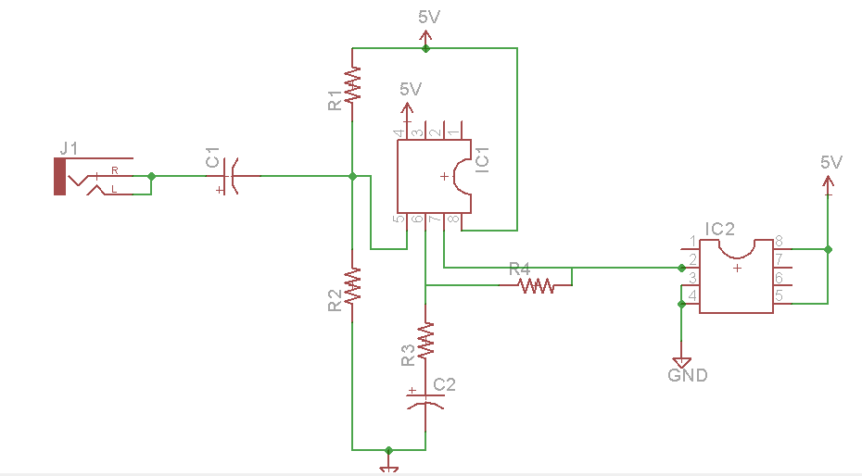
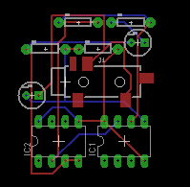
PRE AMPLIFIER ON EAGLE SOFTWARE

Slide 10
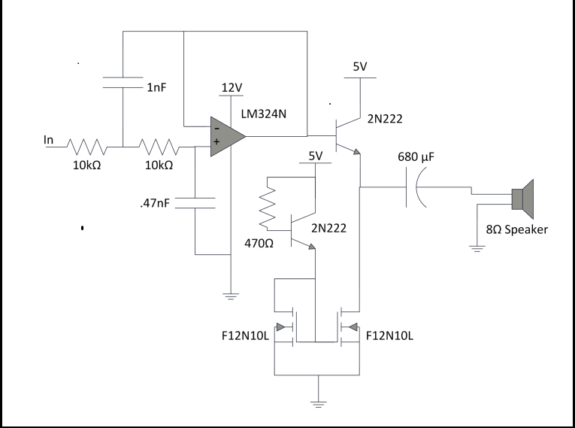
POST AMPLIFIER CIRCUIT
Low pass filter is used to reject all frequencies that are not in the audible region.
The cut off frequency is about 23kHz.
Two passive RC filters because cascading two RC filters has a gain of -­6dB at the cut off frequency.

Slide 11
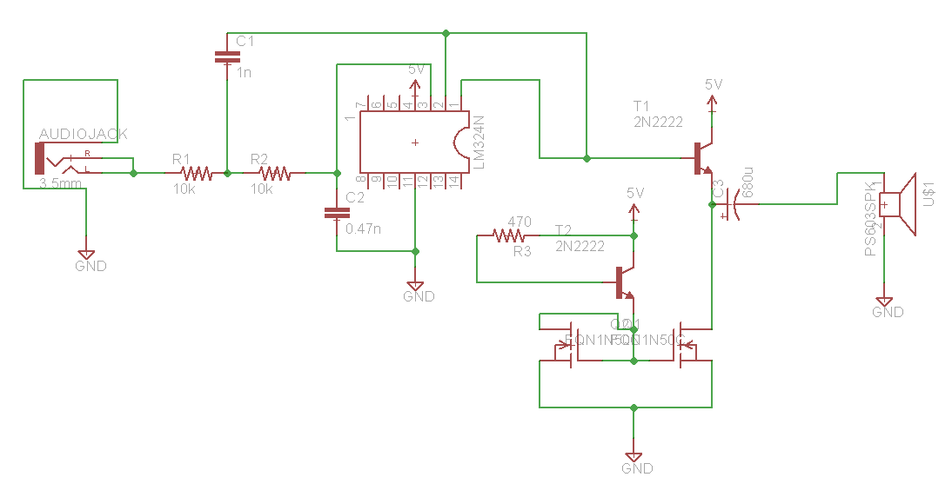
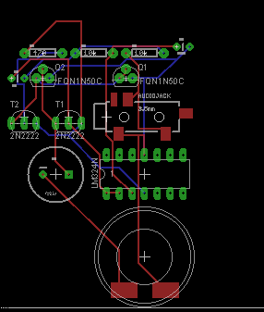
POST AMPLIFIER ON EAGLE SOFTWARE

Slide 12

Sound Beam Angle
Given Data
lamda=wavelength of sound wave
d=distance between adjacent speakers
td=time delay between signals going to adjacent speakers
$θ=sina((−V_{s}/2$πd).td)
Vs=lamda*f

Slide 13
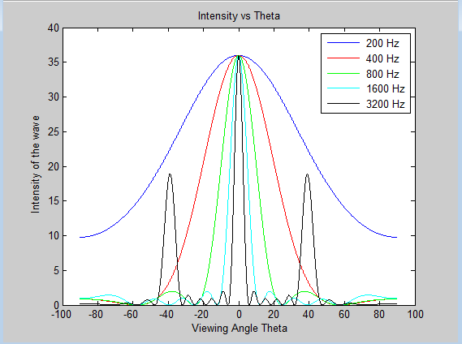
OUTPUT FOR VIEWING ANGLE
For Time Delay=0

Slide 14
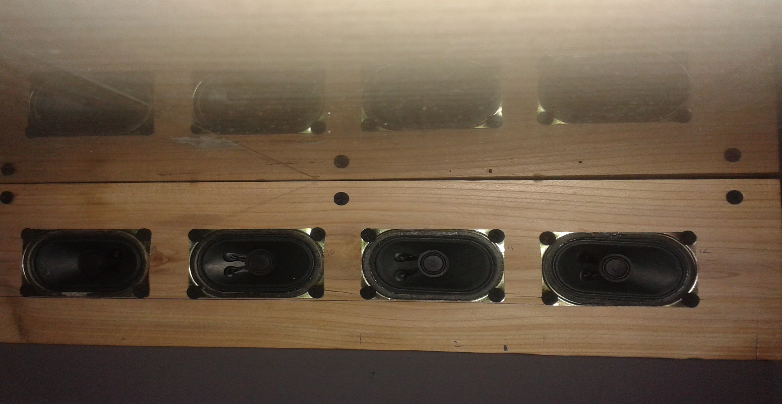
SPEAKER ALIGNMENT

Slide 15
APPLICATIONS
Quadraphonic
Sonar testing apparatus
Enhancing bass

Slide 16
WORKS To Do
Circuit design for ADC
Circuit Design for Atmega
Generation of 12 different Phase to drive speakers
Circuit Design of DAC
Test the Module

Slide 17
REFERENCES
Paul Crilly, Richard Hartnett, Rosie Santrach, Carlos Palenzuela Department of Engineering, Electrical Engineering, U.S. Coast Guard Academy, New London “A Novel Approach to Teaching Phased Array Antenna Systems ”

Slide 18
THANK YOU

